Slide 1
Using Cluster Methodologies to Create Better
ETF Trading prediction models
---Group5---
Preeti Bekal
Wyatt Marciniak
Neel Shah

Slide 2
Objective:
Predict monthly Exchange Traded Funds (ETFs) price movements accurately
Development a market trading strategy
Create an Asset Allocation tool for portfolios
Focus on direction (not magnitude)
Compare multiple subsets of data and models
Backtest to see if we can beat the market

Slide 3
Data:
10 Sector ETFs (SPDR) vehicles for the 10 major sectors of the US economy:
Biotech, Consumer Discretionary/Staples, Energy, Finance, HealthCare, Industrials, Materials, Technology, Utilities
US Treasury Rates:
1,2,3,5,7,10,30 years
Exchange Rates (Top comparable economies by Trade with the US):
Brazil, Canada, China, Japan, Mexico, South Korea, Switzerland, Eurozone
Market Indicators:
Gold Price, Oil, USD, VIX, Federal Funds rate, UM Sentiment Index, Home Price Index, Unemployment, BACHY Bond Index, Auto-Sales

Slide 4
Methodology:
Mine and scrub data → Group all observation and explanatory variables in 1 Data Frame
Subset Data by Correlation and Simple Linear Regression Testing
Use Multiple Thresholds here
Conduct Cluster Testing to identify similar groups, behaviors and trends
Use Multiple Methods to cover a wider range of possibilities
Use these Cluster Tags to run a subsetting procedure to create new filtered data sets
Filtered by the clustering methods + 1 full data procedure
Create Linear and Decision Tree Models
Predict and Conduct Backtests
Collect wide array of results and analysis

Slide 5
Step 1 - Mining, Cleaning and Organizing the Data:
Custom R Script using the Quantmod API
Yahoo Finance (Equity and ETF Data)
FRED Database(Interest/Exchange Rates and Market Indicator Data)
Time Frame: Monthly
ETFs are “sector proxies” so large price swings at higher frequencies are less likely
Monthly adjustments are very sound and reasonable asset allocation assumptions
Training Data: [08-06 : 14-06] → June 2006 to June 2014 = 73 months
Testing Data: [14-07 : 17-06] → July 2014 to June 2017 = 36 months
Classification - Add factor data to all initial data sets → “up” / “down”

Slide 6
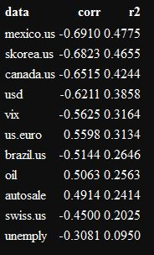
Step 2 - Analyze Correlations and Create Initial Subsets
Evaluate the data sets correlation to each of the 10 ETFs
Correlation with a simple regression fit (R^2)
We are looking at 2 subset criteria:
abs(Correlation) >= 0.00
All starting data gives us a good base to compare with
abs(Correlation) >= 0.30
Correlations around 30% are “weak” → Keep (potential)
The ordered indicators are stored with their test results

Slide 7
Step 3 - 6: Clustering the Data - K-means and Hierarchical Clustering
We are using clustering to attempt to identify redundant or highly correlated parameters before testing them in models.
In this way we attempted to:
Understand the behavioral similarities of market driving data
Remove the collinearity of the parameters for Linear Models
Remove redundant classifiers from the Decision Tree Models
We cluster the data based on distance methods : Euclidean and Correlation
Selecting Best K : Use (1) PCA output (2) WSS plot (3) Multiple Plotted Ks
Selecting Best H Cluster: (1) KSG Plot (2) Multiple Plotted Orderings

Slide 8
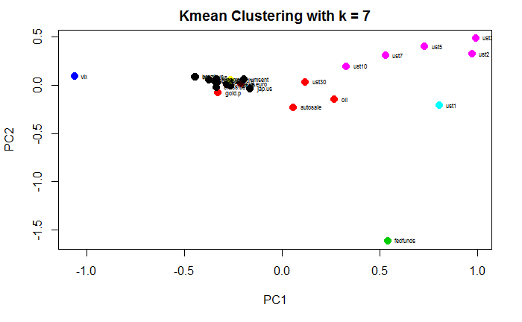
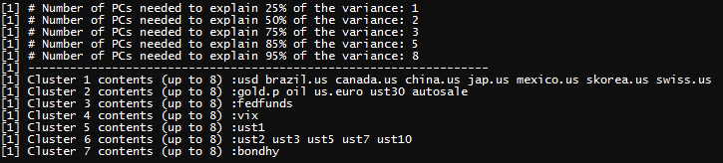
K-means Clustering - Based on Euclidean Distance
PCA Testing for explained variance:
3-5 components
> 75% of the variability
2D Plot is relatively good
Cluster Content “Themes”
USTs
FX
Oil + AutoSale

Slide 9
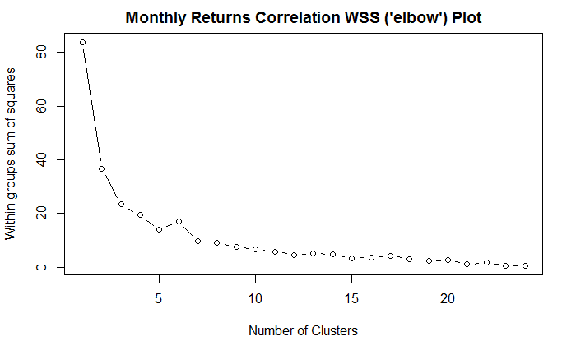
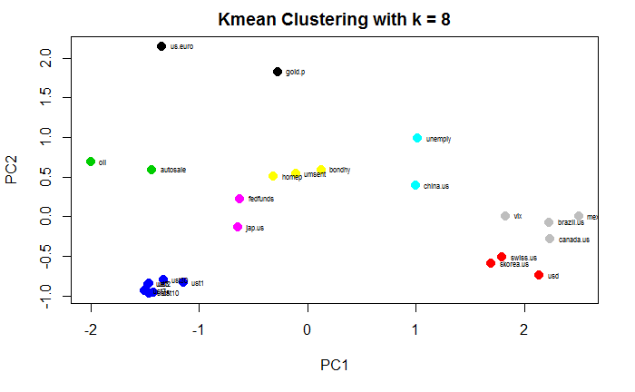
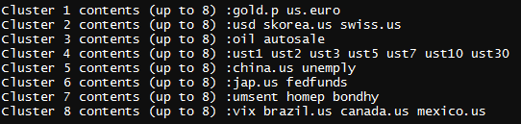
K-means Clustering - Based on Correlation Distance

Slide 10
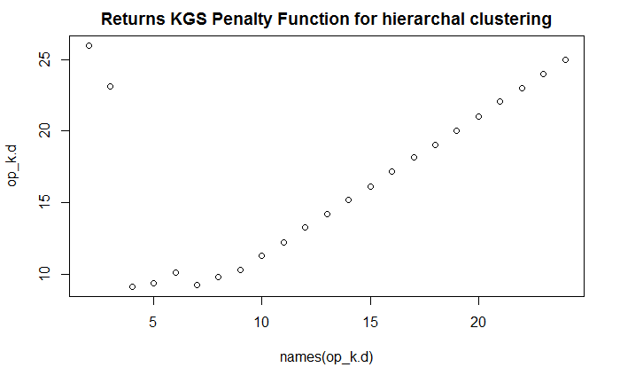
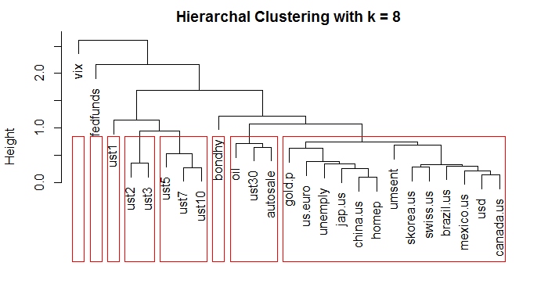
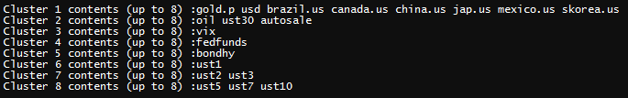
Hierarchical Clustering - Based on Euclidean Distance

Slide 11
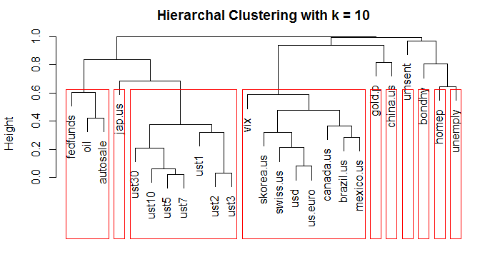
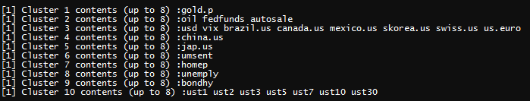
Hierarchical Clustering - Based on Correlation Distance

Slide 12
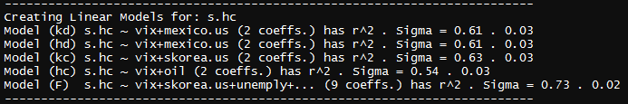
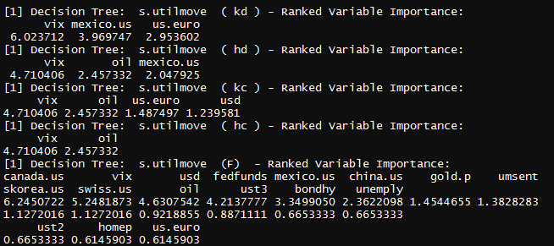
Step 7-8: Build Linear Models and Decision Trees - BackTest/Prediction
Automated Procedures
5 models (per cluster type)
Multivariate Linear Reg
Decision Trees (Rpart())
Predictions = “up”/”down”

Slide 13
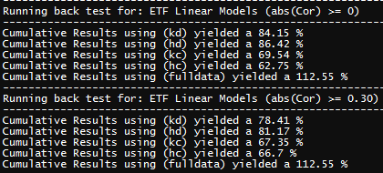
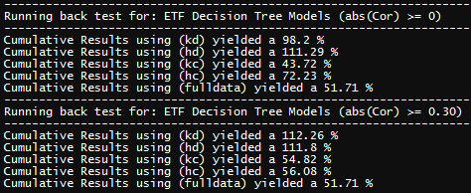
Final Step: Analyze 36 month Backtesting results and assess actual viability of methodologies
Holding The Market
DJIA = 24.76%
SP500 = 21.74%
ETFs = 28.43%
Full Data models performed much better against linear models than decision trees
All Cumulative Model Strategies (with and without clustering) outperformed the markets and holding long all ETFs

Slide 14
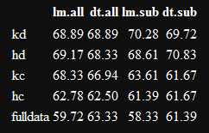
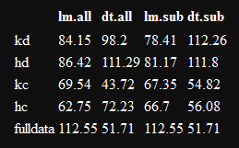
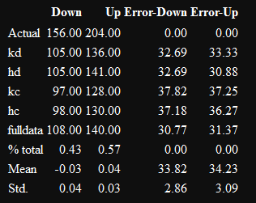
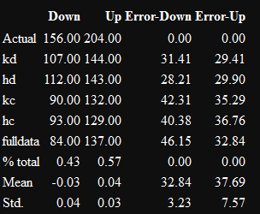
Looking at accuracy vs return %:
Cumulative Accuracy %
Cumulative Return %
lm.sub Confusion Matrix
dt.sub Confusion Matrix

Slide 15
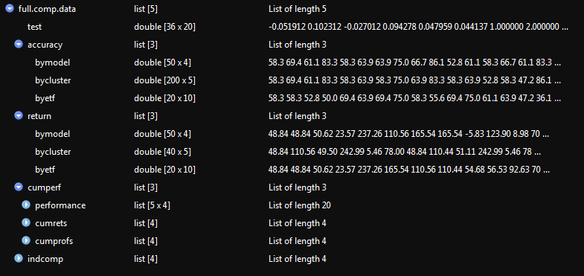
Next Steps:

Slide 16
Using Cluster Methodologies to Create Better
ETF Trading prediction models
---Group5---
Preeti Bekal
Wyatt Marciniak
Neel Shah

